Slide 1
The Rise and Fall of Rome
Chapter 1 Section 1

Slide 2
Essential Question
What accounts for the rise and fall of Rome
How did the Roman empire gain and maintain power over people
How did Rome’s achievements in architecture and technology encourage its growth?
How did Rome’s environment affect its growing economy and trade networks?territories?

Slide 3
Rome
Two thousands years, the world was ruled by Rome. From turmoil, Rome rose into a strong empire. Rome embraced hundreds of cultures

Slide 4
A prosperous Empire
The first emperor of Rome was Augustus
Augustus paved the way for 200yrs. of peace and prosperity
This time is known as Pax Romana or “Roman Peace”

Slide 5
Legacy of Augustus;
Making the empire strong and safe
Professional and permanent army for security (The U.S has branches of professional armies)
Praetorian guard: in charge of guarding the emperor (Like the Secret service protecting the President)

Slide 6
Legacy of Augustus;
Expanding and Rebuilding Rome
Legions of Augustus conquered new territories; Spain, Gaul, Austria, Hungary, Romania, and Bulgaria
Rebuilt Rome’s government by dividing Rome into provinces (similar to states), proconsuls managed the provinces (similar to governors)

Slide 7
Example of Rome provinces
Rome: without provinces
X
X
X
p
p
p
P= Provinces
X=proconsul/leader
p
p
p
X
X
X
Answer the question in your notebook:
Do you think dividing Rome into provinces was a good idea? Explain your answer

Slide 8
After Augustus many emperors ruled; some bad some good. Over time, the Empire expanded to 3.5 million miles.
Eventually Rome began to decline
WHY?

Slide 9
The Fall of Rome
With a partner discuss the factors that may have led to the fall of Rome (students share ideas with class)

Slide 10
Theories that led to the fall of Rome
A declining economy (MAIN THEORY)
inflation
defending the vast empire
military spending
Poor leadership
political corruption

Slide 11
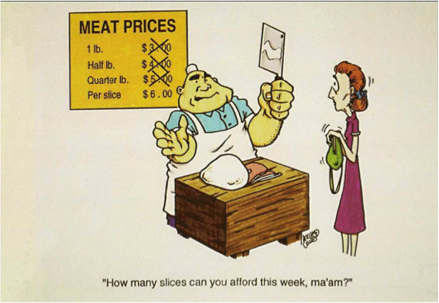
A Declining Economy:
Inflation
Inflation
Declining economy: people purchased fewer goods, shopkeepers lost money
Rome suffered from inflation: rapid increase in price
Money loses value = inflation

Slide 12
Why did inflation occur
Weak economy = fewer taxes paid
Less money in government = could not afford to defend territories
Government put less gold in coins = money loses value
Less gold in coins = prices going up = people stopped using money and started to barter (trade) goods

Slide 13
Defending Rome:
Empire too big and cost to much to defend
Maintaining an army to defend Rome’s boarders drained the government
Government paid Germanic warriors to serve in army (cheaper than Roman Citizens)
Emperors forced to raise taxes

